Slide 1
Working with Data and Macros
Microsoft Excel 2013
Lesson 9

Slide 2
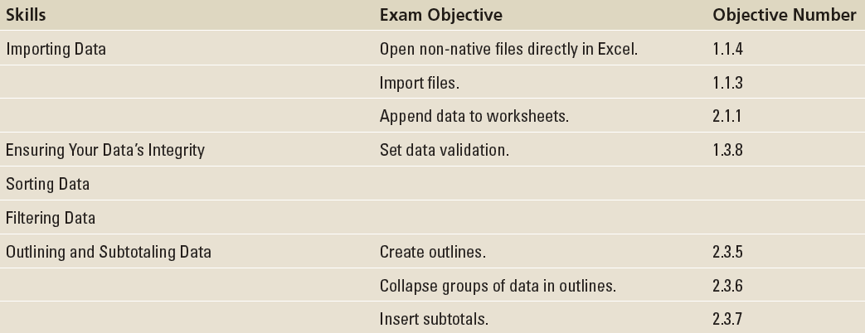
Objectives

Slide 3
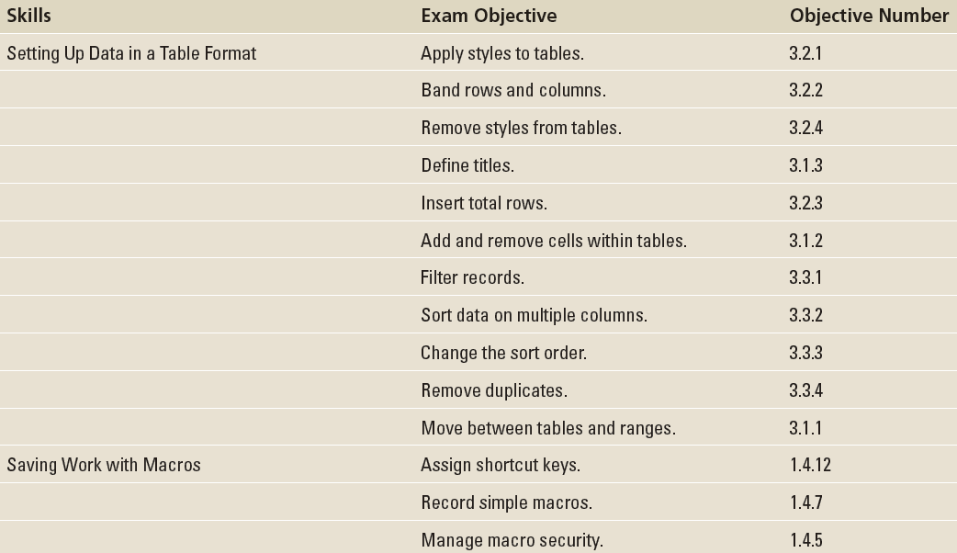
Objectives

Slide 4
Step by Step: Open a Non-Native File Directly in Excel
GET READY. Before you begin these steps, LAUNCH Microsoft Excel.
If the active workbook is not a new, blank workbook, then click the FILE tab. In Backstage, click New, and then click the thumbnail marked Blank workbook.
On the DATA tab, click Get External Data. Then click From Text.
In the Import Text File dialog box, locate and click the 09 NA-EST2012-01.csv file in the Lesson 9 folder. Click Import.

Slide 5
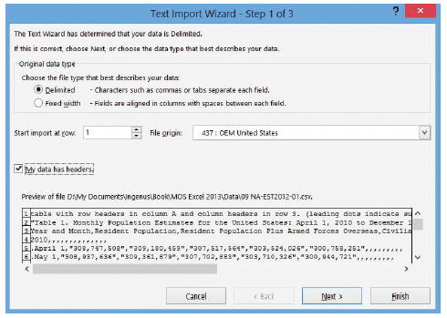
Step by Step: Open a Non-Native File Directly in Excel
In Step 1 of the Text Import Wizard, notice the preview at the bottom (riht). This is Excel’s best guess, for the moment, as to how the data should be formatted. There are population figures rendered in “quotation marks” with commas between each figure. Here, each comma acts as the delimiter, and it’s difficult to judge whether each figure between the commas will be the same length. Under Choose the file type that best describes your data, choose Delimited, and select My data has headers.

Slide 6
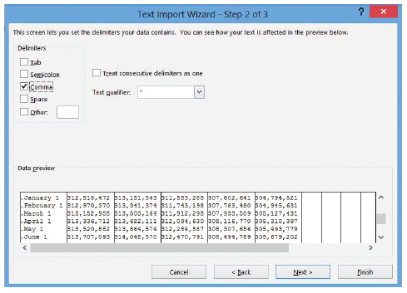
Step by Step: Open a Non-Native File Directly in Excel
The preview shows the headers starting on row 3. Thus, for the Set import at row option, choose 3. Click Next.
In Step 2 of the wizard, shown at r ight, uncheck Tab because the preview does not indicate long spaces between the figures. Check Comma. Set Text qualifier to " (quotation mark). Scroll down the Data preview pane, and notice now that Excel has found the column separations between figures. Click Next.

Slide 7
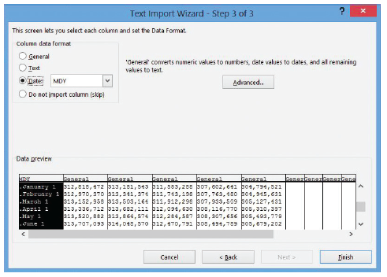
Step by Step: Open a Non-Native File Directly in Excel
Step 3 of the wizard, right, lets you establish the data type for each discovered column. Click the first column in the Data preview pane. Then, under Column data format, click Date. Click Finish.

Slide 8
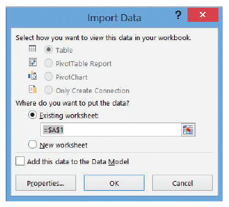
Step by Step: Open a Non-Native File Directly in Excel
In the Import Data dialog box that appears next (above), leave Where do you want to put the data? set to Existing worksheet. Click OK.
Shorten the width of column A to 16 (see Lesson 7, “Formatting Worksheets”).

Slide 9
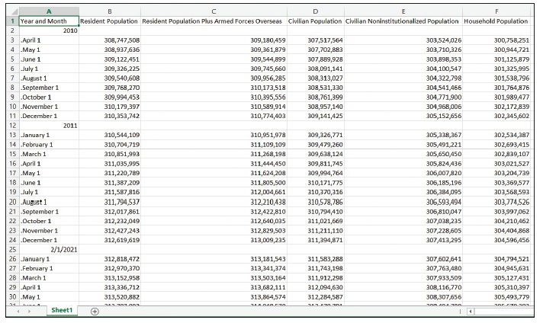
Step by Step: Open a Non-Native File Directly in Excel
The worksheet that Excel has generated, shown at right, shows United States population estimates for each month from April 2010 to December 2012. Excel could not make sense of the dates in column A, so it left the data type set to General for most of the cells. However, it did make an error in attempting to convert the year in cell A25. To correct it, begin by deleting rows 2, 12, and 25.

Slide 10
Step by Step: Open a Non-Native File Directly in Excel
Click cell A2, type April 2010, and press Enter.
Drag the fill handle from cell A2 down to cell A34 and release (see Lesson 2, “Working with Microsoft Excel 2013”). Excel changes the entries in column A to proper months.
Delete rows 35 through 40.
SAVE the workbook in the Lesson 9 folder as 09 Monthly Census Data Solution.
CLOSE the workbook and leave Excel open for the next exercise.

Slide 11
Step by Step: Get External Data
GET READY. Before you begin these steps, LAUNCH Microsoft Excel.
If the active workbook is not a new, blank workbook, then click the FILE tab. In Backstage, click New, and then click the thumbnail marked Blank workbook.
On the DATA tab, click Get External Data, and then click From Access.
In the Select Data Source dialog box, locate the 09 GMcC Customer contacts.accdb database file. Select it and click Open.

Slide 12
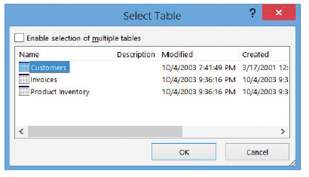
Step by Step: Get External Data
In the Select Table dialog box shown below, click Customers (the table we want to import), and then click OK.

Slide 13
Step by Step: Get External Data
In the Import Data dialog box (right), click Table. Under Where do you want to put the data, click Existing Worksheet and ensure the text box reads =Sheet1!$A$1.

Slide 14
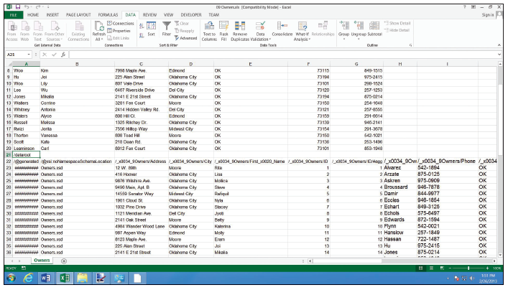
Step by Step: Get External Data
Click OK. Excel takes a moment to query the database. Soon, it displays a fully formatted table (right), complete with AutoFilter buttons in the headers, which you learn more about later in this lesson in “Using AutoFilter.”
SAVE the workbook in the Lesson 9 folder as 09 2005 Customers Solution.
CLOSE the workbook and leave Excel open for the next exercise.

Slide 15
Step by Step: Append Data to a Worksheet
GET READY. OPEN the 09 Owners.xls workbook for this lesson.
Click cell A21.
On the DATA tab, click Get External Data, then click From Other Sources, followed by From XML Data Import.
In the Select Data Source dialog box, locate and select the 09 2010_Owners.xml data file. Click Open.

Slide 16
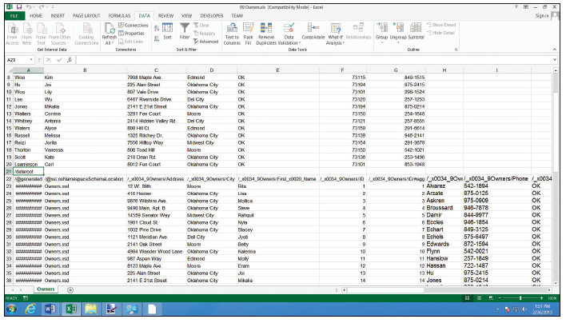
Step by Step: Append Data to a Worksheet
In the Import Data dialog box, click Existing worksheet, and then click OK. Although a list of customers is appended to the end of the worksheet, the columns don’t line up, as the figure below clearly indicates. This is typical of appended data.

Slide 17
Step by Step: Append Data to a Worksheet
To correct the problem, begin by moving the first names from cell range E23:E75 to B23:B75. Overwrite the existing contents in column B.
Move the last names from cell range H23:H75 to A23:A75. Overwrite the existing contents in column A.
Repeat the process for the states in column J that should be in column E, the ZIP codes in column K that should be in column F, and the phone numbers in column I that should be in column G.

Slide 18
Step by Step: Append Data to a Worksheet
Delete columns H through L.
Delete rows 21 and 22.
Replace all 11 instances of Dell City in column D with Del City.
SAVE the workbook in the Lesson 9 folder as 09 Car Owners Solution.xlsx. CLOSE the workbook and leave Excel open for the next exercise.

Slide 19
Step by Step: Restrict Cell Entries to Certain Data Types
GET READY. OPEN the 09 Vet Clinic Patients workbook for this lesson.
Click the FILE tab and select Save As. SAVE the workbook in the Lesson 9 folder as 09 Vet Clinic Patients (Active) Solution.
Freeze rows 1 through 5 in both worksheets in the workbook (see Lesson 8, “Managing Worksheets”).
In the Client list worksheet, select column L (Area Code).

Slide 20
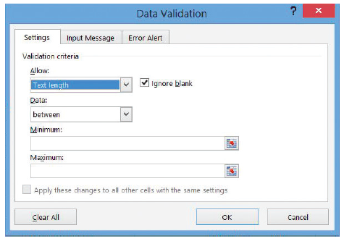
Step by Step: Restrict Cell Entries to Certain Data Types
On the DATA tab, in the Data Tools group, click Data Validation. The Data Validation dialog box opens.
Click the Settings tab.
In the Allow list box, choose Text length. This is the first step in the creation of a rule governing how many characters each new entry should contain. The dialog box should now appear as depicted above.

Slide 21
Step by Step: Restrict Cell Entries to Certain Data Types
In the Data list box, choose equal to.
Click the Length box and type 3.
Click the Input Message tab. This tab displays a ScreenTip whenever you select a cell in this specially validated area.
Click the Title box and type Rule:

Slide 22
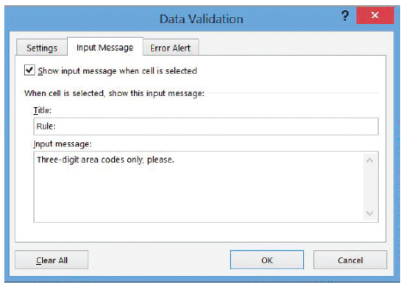
Step by Step: Restrict Cell Entries to Certain Data Types
Click the Input message box and type Three-digit area codes only, please. The Data Validation dialog box should now appear as shown at right.
Click the Error Alert tab. Excel notifies a user who missed your ScreenTip that the data he has entered is invalid.

Slide 23
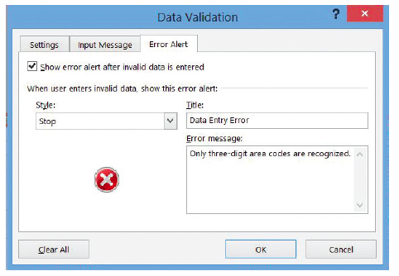
Step by Step: Restrict Cell Entries to Certain Data Types
Click the Title box and type Data entry error.
Click the Error message box and type Only three-digit area codes are recognized. This message is displayed in a dialog box whenever an invalid entry is made in column L. The dialog box should now appear as shown above.

Slide 24
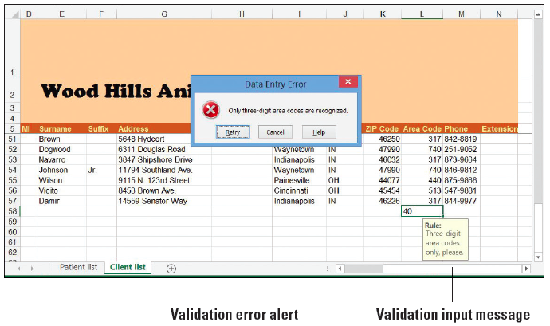
Step by Step: Restrict Cell Entries to Certain Data Types
Click OK.
To test the new validation rule, click cell L58. You should see the notification message you typed into the Input Message tab.
Type 40 and press Enter. Excel displays an alert dialog box with the message you created (above).
Click Cancel. The partial entry in cell L58 is erased.
PAUSE. SAVE the workbook and leave it open for the next exercise.
Notes:
Take Note: Excel’s validation rules pertain to only new data as you enter it into the workbook, not to data that existed in the workbook prior to creating the rules. Don’t rely on validation rules to correct errors that might already exist, but to catch any new errors that might arise.

Slide 25
Step by Step: Allow Only Specific Values to Be Entered in Cells
GET READY. USE the workbook from the previous exercise.
Click the FILE tab and select Save As. SAVE the workbook in the Lesson 9 folder as 09 Vet Clinic Patients (Active) Solution 2.
Click the Patient list tab.
Select column D.
On the DATA tab, in the Data Tools group, click Data Validation.
In the Data Validation dialog box, click the Settings tab.
In the Allow list box, choose List. The Source box appears at the bottom of the dialog box.
Click the Source box. Type M,F,N being careful to include the commas.
Uncheck the Ignore blank box.
Click the Input Message tab. Click the Input message box and type Male, Female, or Neutered.

Slide 26
Step by Step: Allow Only Specific Values to Be Entered in Cells
Click OK. Now anyone entering a new patient into the database must specify the animal’s gender.
Select column E (Owner #).
In the Data Tools group, click Data Validation.
Click the Settings tab. In the Allow list box, click List.
On the right side of the Source box, click the Collapse Dialog button.
With the Data Validation dialog box collapsed, click the Client list worksheet tab.
Select column A (Client #).
At the end of the Source box, click the Expand Dialog button. The full dialog box returns, and the Source box should now read ='Client list'!$A:$A.
Unselect the Ignore blank and In-cell dropdown boxes.

Slide 27
Step by Step: Allow Only Specific Values to Be Entered in Cells
Click the Error Alert tab. Choose Warning from the Style box.
In the Error message box, type Owner must be the number for a pre-existing client.
Click OK. Now the Owner # column may contain only numbers for clients who appear in the Client # column of the Client list worksheet.
To make sure your new validation rules are working, in the Patient list worksheet, at the bottom of the list, click cell A58 and attempt to type the following data:
Murdock Dog Rottweiler B 61
After you attempt to enter B into column D, respond to the error dialog by clicking Retry and by typing M.

Slide 28
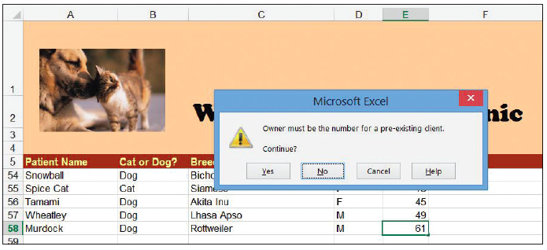
Step by Step: Allow Only Specific Values to Be Entered in Cells
After you attempt to enter 61 into column E, respond to the error dialog shown below by clicking No and typing 31.
PAUSE. SAVE the workbook and leave it open to use in the next exercise.
Notes:
Take Note: It’s still feasible for an invalid value to remain in a worksheet after the user has been warned that it’s invalid. For example, if in the previous last step you were to click Yes instead of No, the value 61 would remain in column E, even though there is no client numbered 61 in column A of the Client list worksheet. Conceivably, this way you can purposefully enter a new canine patient into the list without an owner, if you intend to add the owner’s information later.

Slide 29
Step by Step: Remove Duplicate Rows from a Worksheet
GET READY. USE the workbook from the previous exercise.
SAVE the current workbook as 09 Vet Clinic Patients (Active) Solution 3.
Click the Client list worksheet tab.
Click cell A58 and in row 58, type the following data:
0053 Mrs. Mary Jane Brink 704 Fairway Drive Cincinnati OH 45250 513 255-1655
Select the cell range A5:N58.

Slide 30
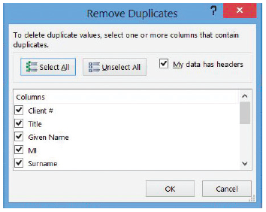
Step by Step: Remove Duplicate Rows from a Worksheet
On the DATA tab, in the Data Tools group, click Remove Duplicates. The Remove Duplicates dialog box appears (right).

Slide 31
Step by Step: Remove Duplicate Rows from a Worksheet
Remove the check beside Client # in the Columns list. If duplicate names and addresses appear in the list, it’s likely their client index numbers were not duplicated.
Leave the My data has headers box checked. This way, Excel won’t treat row 5 as though it contained data.
Click OK. Excel responds with a dialog box stating one duplicate value set (the one you just entered) was removed.
Click OK to dismiss the dialog box. Note the second (lowermost) instance of the duplicate entry was removed, from row 58.
PAUSE. SAVE the workbook and leave it open to use in the next exercise.

Slide 32
Step by Step: Sort Data on a Single Criterion
GET READY. USE the workbook from the previous exercise.
SAVE the current workbook as 09 Vet Clinic Patients (Active) Solution 4.
In the Patient list worksheet, click cell E6. Note this is the top row of the Owner # column and its entries are all numerical.
Hold the Shift key down while clicking cell A58. This selects the entire range you wish to sort.
On the DATA tab, in the Sort & Filter group, click the Sort Smallest to Largest button (with A on top of Z, and an arrow pointing down). The list is now sorted in ascending numerical order (despite the presence of the alphabet on the button) by Order #, which was the first column you clicked in when selecting the range.
Notes:
Another Way: You can also quickly sort the data in a range in alphabetical order, even without selecting the entire range first, by right-clicking one cell in the column you want to sort, clicking Sort, and then clicking Sort A to Z.

Slide 33
Step by Step: Sort Data on a Single Criterion
Click cell A6.
Hold the Shift key down while clicking cell E58.
Click the sorting button again, whose ScreenTip is now the Sort A to Z button (because you’re sorting alphanumeric text). This time, the list is sorted by Patient Name, and again, the first column you clicked in when selecting the range. Murdock the Rottweiler, which you previously added to row 58 and that now appears on row 45.
PAUSE. SAVE the workbook and leave it open to use in the next exercise.
Notes:
Take Note: The Sort A to Z button (a.k.a., Sort Smallest to Largest) and Sort Z to A button (also known as Sort Largest to Smallest) assume that the column you wish to use as your sorting criterion is the one that contains the cell pointer. In selecting a range, whether you hold down Shift to select the opposite corner (as you did in this exercise) or whether you drag the pointer from one corner to the opposite corner, the cell pointer resides in the cell that you clicked on first.
Troubleshooting: Before sorting a range, make sure you select the entire range first, including the rightmost column(s). Excel leaves any contents outside the selected sort range exactly as they are, which leaves you with out-of-order contents should you fail to select the entire width of the range.

Slide 34
Step by Step: Sort Data on Multiple Criteria
GET READY. USE the workbook from the previous exercise.
Click the Client list tab.
Select the range A5:N57.
Name the range Clients.
On the DATA tab, in the Sort & Filter group, click Sort. The Sort dialog box appears.
In the Sort by list box, under Column, choose Surname.
Click Add Level.
In the Then by list box that appears, choose Given Name.
Click Add Level.
In the next Then by list box, choose MI (middle initial).

Slide 35
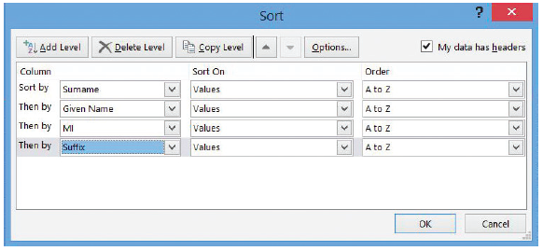
Step by Step: Sort Data on Multiple Criteria
Click Add Level again.
In the next Then by list box, choose Suffix. The dialog box should now appear as dhown at right.
Leave My data has headers checked, so that Excel won’t treat the headers row as a data entry.
Click OK. The clients list is now sorted alphabetically, with people sharing the same surname sorted alphabetically by first name. Although the client numbers appear all out of sort, the data is unchanged and the database itself retains its full integrity.
PAUSE. SAVE the workbook and leave it open for the next exercise.

Slide 36
Step by Step: Sort Data Using Cell Attributes
GET READY. USE the workbook from the previous exercise.
On the Patient list worksheet, select column E.
Right-click the column, and then click Insert in the shortcut menu.
With column E selected, on the DATA tab, in the Data Tools group, click Data Validation.
In the Data Validation dialog box, click Clear All. Click OK.
Click cell E5 and type Spayed/Neutered.
Type S into column E for the following row numbers: 7, 22, 23, 26, 35, 38, 47, and 51.
Notes:
Troubleshooting: When creating a new column to the right of one governed by a data validation rule, the new column acquires that same rule even if it’s intended for a different purpose. To clear this rule, select the new column, bring up the Data Validation dialog box, and click Clear All as demonstrated previously.

Slide 37
Step by Step: Sort Data Using Cell Attributes
Type N into column E for the following row numbers: 6, 8, 9, 10, 11, 13, 14, 16, 17, 18, 20, 21, 25, 28, 30, 31, 32, 33, 36, 37, 39, 42, 43, 44, 46, 48, 49, 50, 53, 55, 56, 57, and 58.
Select column E.
On the DATA tab, in the Data Tools group, click Data Validation.
In the Data Validation dialog box, click the Settings tab. Under Allow, choose List.
In the Source box, type N,S.
Click the Input Message tab. In the Input message box, type S = Spayed, N = Neutered. Click OK.
Select the range E6:E100. On the HOME tab, in the Styles group, click Conditional Formatting. Click New Rule.

Slide 38
Step by Step: Sort Data Using Cell Attributes
In the New Formatting Rule dialog box, choose Format only cells that contain in the Select a Rule Type list.
In the list box, under Format only cells with, choose No Blanks.
Click Format.
In the Format Cells dialog box, click the Fill tab. Choose the sixth color swatch from the left in the third row. Click OK.
Click OK. Now both spayed and neutered animals should appear shaded.
Select the range A5:F58. Name the range Patients.
On the DATA tab, in the Sort & Filter group, click Sort.

Slide 39
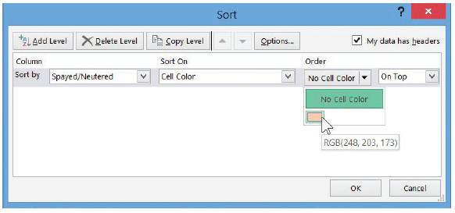
Step by Step: Sort Data Using Cell Attributes
In the Sort dialog box, in the Sort by list, choose Spayed/Neutered.
In the Sort On list, choose Cell Color.
Click the down arrow next to No Cell Color. As the figure at right shows, the list box that appears shows only those colors that are actually in use for conditional formatting—in this case, only one swatch.

Slide 40
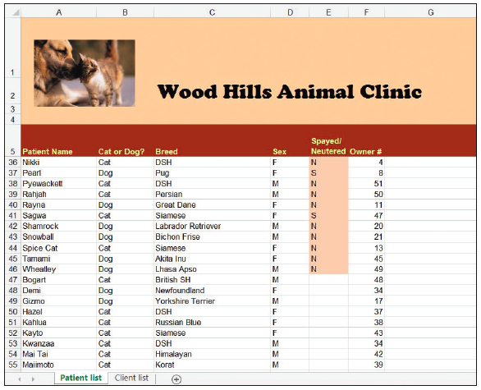
Step by Step: Sort Data Using Cell Attributes
Click OK. The sorted worksheet should now appear as shown at right. All the “N” and “S” animals are grouped together at the top, with the two types mingling among each other. All the non-operated-on animals are bunched toward the bottom.
PAUSE. SAVE the workbook. Leave it open for the next exercise.
Notes:
Troubleshooting: Any table you intend for Excel to sort must not contain merged cells (see Lesson 6). For Excel to be able to exchange cell contents between positions evenly, each row must have an identical number of cells. Each of the cells in a column may be formatted differently, though their widths may not vary.

Slide 41
Step by Step: Use AutoFilter
GET READY. USE the workbook from the previous exercise.
SAVE the current workbook as 09 Vet Clinic Patients (Active) Solution 5.
Click the Client list worksheet tab. In the Name box, type Clients and press Enter. Excel highlights the data range for the Clients table.
On the DATA tab, in the Sort & Filter group, click Filter. Excel adds down arrow buttons to the field names in all of the columns in the list.

Slide 42
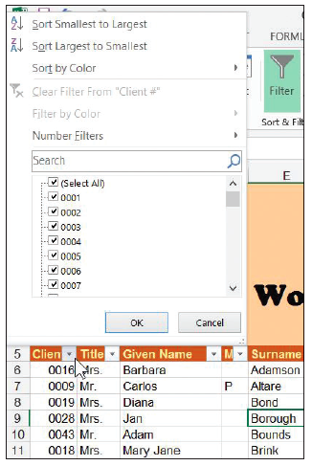
Step by Step: Use AutoFilter
Click the down arrow beside the Client # heading in column A. Excel displays the AutoFilter menu shown at right.
To sort the table by client number, click Sort Smallest to Largest. This gives you a shortcut for sorting that bypasses the menu.

Slide 43
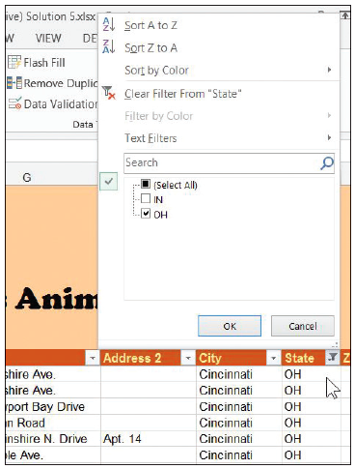
Step by Step: Use AutoFilter
To show just the clients with addresses in Ohio, click the down arrow beside State. In the AutoFilter menu that appears (right), uncheck the (Select All) box to clear all check boxes, and then check OH and click OK.
PAUSE. SAVE the workbook and leave it open to use in the next exercise.

Slide 44
Step by Step: Create a Custom AutoFilter
GET READY. USE the workbook from the previous exercise.
Insert a new column into the Patient list worksheet, between the existing columns D and E.
Clear the validation rules from the new column E.
Add the title Hepatitis inoculation to row 5. Increase the width of the column to make room for the label.

Slide 45
Step by Step: Create a Custom AutoFilter
Type the following dates into the cells shown: E9 1/18/2012 E12 8/16/2011 E14 5/15/2012 E19 3/1/2009 E23 10/19/2010 E27 7/5/2012 E33 2/2/2011 E38 8/15/2012 E39 7/14/2011 E44 9/1/2012

Slide 46
Step by Step: Create a Custom AutoFilter
Select the Patients data range. The range should have automatically stretched to include the new column.
On the DATA tab, in the Sort & Filter group, click Filter.
Click the down arrow beside Hepatitis inoculation. In the menu, click Date Filters, and then click Custom Filter. The Custom AutoFilter dialog box opens.
In the first list box just below Hepatitis inoculation, choose is before. In the box to the right, type 1/1/2012.
Click the Or button between the two rows of list boxes.

Slide 47
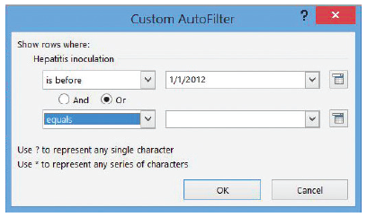
Step by Step: Create a Custom AutoFilter
In the second list box below Or, choose equals. Leave the list box blank (literally meaning “blank” or “nothing”). The dialog box should now appear as shown at right.
Click OK. After the dialog box disappears, Excel filters out all entries in the patient list where the patient is known to have had a hepatitis inoculation in 2012 or later. What remains are both the animals known to have been inoculated in 2011 or earlier, or whose inoculation dates are not known.

Slide 48
Step by Step: Create a Custom AutoFilter
Click the filter button beside Hepatitis inoculation again. In the menu, click Date Filters, and then click Custom Filter.
In the second list box that currently reads equals, choose the blank entry at the top of the list. The box should now be empty.

Slide 49
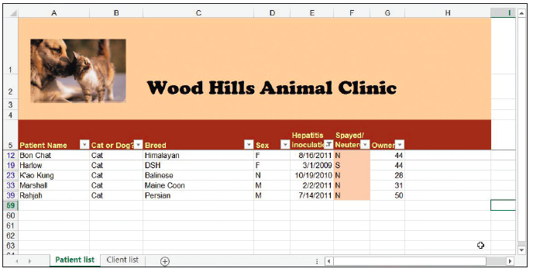
Step by Step: Create a Custom AutoFilter
Click OK. The list should now show only the five animals known to have been inoculated in 2011 or earlier (below).
Click the filter button beside Hepatitis inoculation again. In the menu, choose Clear Filter from “Hepatitis inoculation”.
PAUSE. SAVE the workbook and leave it open to use in the next exercise.

Slide 50
Step by Step: Filter Data Using Cell Attributes
GET READY. USE the workbook from the previous exercise.
In the Patient list worksheet, click the Spayed/Neutered button down arrow.
In the menu, click Filter by Color.
In the popup menu, choose the pink swatch. Excel now shows only those animals that have been spayed or neutered.
PAUSE. SAVE the workbook and leave it open for the next exercise.

Slide 51
Step by Step: Group and Ungroup Data
GET READY. USE the workbook from the previous exercise.
SAVE the current workbook as 09 Vet Clinic Patients 130114 Solution. Grouping data is best reserved for final reports and not for active databases where new data might be entered later.
With the Patient list worksheet active, on the DATA tab, in the Sort & Filter group, click Clear.
Click the down arrow button beside Cat or Dog? In the menu, click Sort A to Z. Now, all the cats are clustered together at the top, and dogs at the bottom.
Right-click the heading for row 30, the row where the first dog appears. Click Insert in the shortcut menu.
Notes:
Take Note: Enrolling a set of records into a group changes the behavior of AutoFilters that might incorporate that group. For example, when you try to sort a column, only the records that are not members of a group are sorted. Once records are grouped, their order is fixed and their usefulness as parts of an active database is reduced, especially if you add subtotal rows to the middle. For this reason, you should reserve grouping and outlining for workbooks that are presented as final (unchanging) reports for a particular point in time.

Slide 52
Step by Step: Group and Ungroup Data
Select cell H30. Type Number of cats.
Select cell G30. On the HOME tab, in the Font group, click the Bold button. This makes this particular number stand out.
On the HOME tab, in the Editing group, click the AutoSum down arrow. In the menu, click Count Numbers, and then press Enter. Excel inserts a function into the cell that counts the number of contiguous cells in the column just above it that contains numbers—in this case, the owner numbers for clients.
Add a similar function for counting the number of dogs to row 60. (Bypass the validation rule by clicking Yes in the dialog box.)
Select rows 6 through 29 (all the cats).

Slide 53
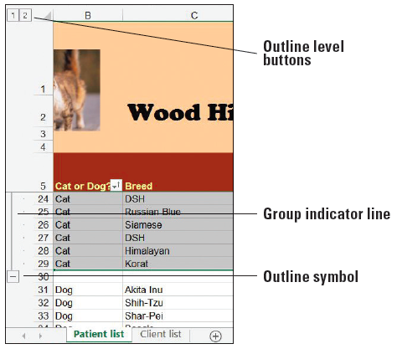
Step by Step: Group and Ungroup Data
On the DATA tab, in the Outline group, click the Group button. A group indicator line is added to the left of the row markers and an outline symbol on the row just below the end of the group (right).
Repeat the process in Steps 8 and 9 for the dogs in rows 31 through 59. Format cell G60 as Bold. In cell H60, type Number of dogs.
To collapse the cats group, click the minus box beside row 30, which contains the cats count. The control becomes a plus box, indicating that when you click on it, it will show hidden rows.
Notes:
Another Way: To collapse all the groups in a worksheet, select the entire worksheet first, and then click Hide Detail in the Outline group of the Data menu tab. To expand all groups, click Show Detail.

Slide 54
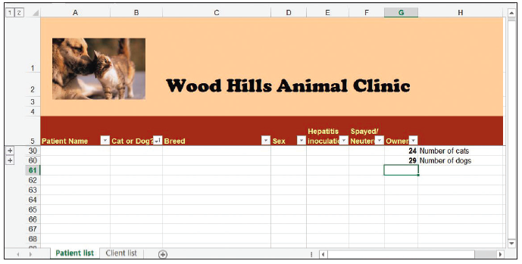
Step by Step: Group and Ungroup Data
Collapse the dogs group with the minus box in row 60. The worksheet now appears fully collapsed (right).
Click the Select All button. In the Outline group, click Show Detail.
Select columns B through F.
In the Outline group, click the Group button. A new column group is created.

Slide 55
Step by Step: Group and Ungroup Data
Click the minus box over column G to collapse the column group. Click the plus box that takes its place to expand it.
Select columns B through G.
In the Outline group, click the Ungroup button. The columnar group disappears.
SAVE and CLOSE the workbook. Leave Excel open for use in the next exercise.

Slide 56
Step by Step: Auto-Outline Data
GET READY. OPEN the 09 Critical Care Expenses workbook for this lesson.
SAVE the workbook in the Lesson 9 folder as 09 Critical Care Expenses 0315 Solution.
Select cell H18. On the HOME tab, in the Font group, click the Bold button. Then, in the Editing group, click the AutoSum button and press Enter. The grand total appears as bold in the cell.
Repeat the grand total process for cell H28.
Select the cell range B10:H28, covering both groups of expenses in their entirety.

Slide 57
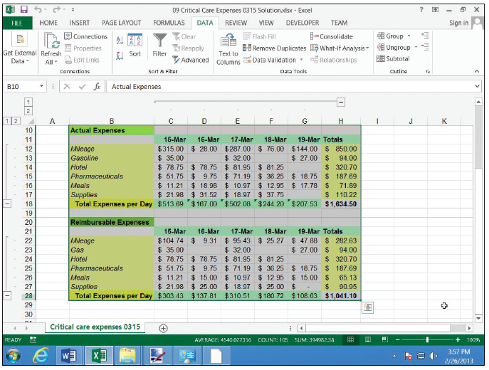
Step by Step: Auto-Outline Data
On the DATA tab, in the Outline group, click the down arrow next to Group. In the menu, click Auto Outline. As the figure shows, Excel auto- matically groups rows 12 through 17 and rows 22 through 27, having spotted the Total Expenses row along the bottom of each cluster. Excel also groups together the columns for March 15 through 19, having spotted the weekly totals columns along the right.
SAVE the workbook and LEAVE Excel open for the next exercise.

Slide 58
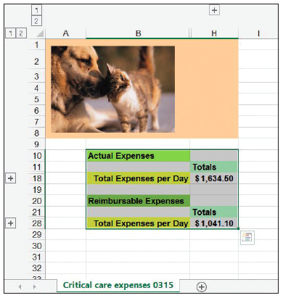
Step by Step: Collapse Groups of Data in an Outline
GET READY. USE the workbook from the previous exercise.
Click all three minus boxes to collapse their respective groups. The worksheet should now appear shrunken to just the grand totals cells you created with the appropriate labels (right).

Slide 59
Step by Step: Collapse Groups of Data in an Outline
Click any of the plus boxes (which replaced the minus boxes) to expand the group to which it’s attached.
To remove the outline entirely, on the DATA tab, in the Outline group, click the Ungroup button arrow. In the menu, click Clear Outline.
SAVE and CLOSE the workbook. Leave Excel open for the next exercise.

Slide 60
Step by Step: Subtotal Data in Outlines
GET READY. OPEN the 09 Server Usage Stats workbook.
SAVE the workbook in the Lesson 9 folder as 09 Server Usage Stats 130831 Solution.
Select the range A5:G140.
On the DATA tab, in the Sort & Filter group, click Sort.
In the Sort dialog box, ensure that the initial sort is by Date, Oldest to Newest. The secondary sort should be by Department, from A to Z. The third should be by Region, from A to Z. Click OK.
On the DATA tab, in the Outline group, click Subtotal. The Subtotal dialog box appears.
In the At each change in list box, click Department.
If necessary, in the Use function list box, choose Sum.

Slide 61
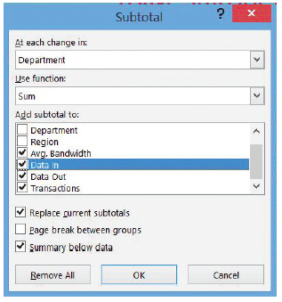
Step by Step: Subtotal Data in Outlines
In the list of columns marked Add subtotal to, check the boxes for Avg. Bandwidth, Data In, Data Out, and Transactions.
Check the Summary below data and Replace current subtotals check boxes, if necessary. The dialog box should now appear as depicted at right.

Slide 62
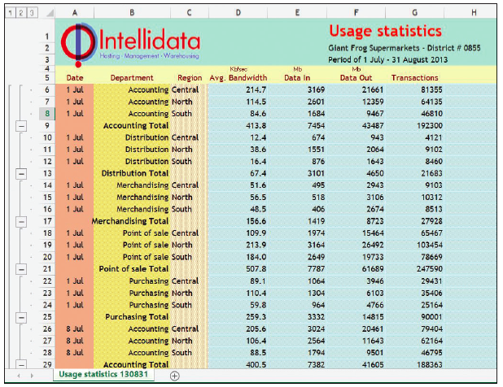
Step by Step: Subtotal Data in Outlines
Click OK. Excel inserts subtotal rows for each company division, grouping together data consumption values for all three corporate regions. It places each of these division row clusters into groups. It then creates a broader group for the entire range, and adds a grand total row at the bottom. The result is a subtotal-endowed worksheet with a three-tier outline (above).
SAVE and CLOSE. Leave Excel open for the next exercise.
Notes:
Take Note: When you remove an outline from an automatically subtotaled range, the subtotal rows that Excel inserted automatically remain. So to return a worksheet to its pre-subtotaled state, you must delete each subtotal row manually.

Slide 63
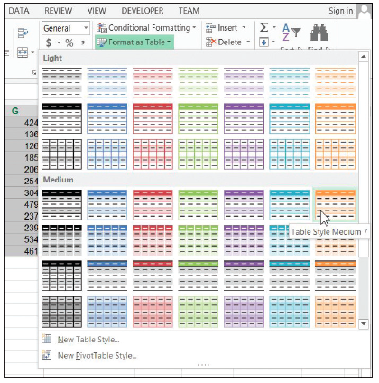
Step by Step: Format a Table with a Quick Style
GET READY. OPEN the 09 Pet Pharma Sales workbook for this lesson.
SAVE the workbook in the Lesson 9 folder as 09 Pet Pharma Sales August Solution.
In the August Sales worksheet, select the data range A6:K93.
On the HOME tab, in the Styles group, click Format as Table. Excel brings up a colorful menu full of sample layouts right).

Slide 64
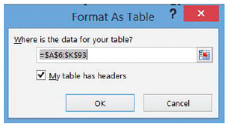
Step by Step: Format a Table with a Quick Style
Click the sample in row 4, column 7 (Table Style Medium 7). The Format As Table dialog box appears (right).
Because the cell reference under Where is the data for your table? is accurate, don't make any changes and click OK. Excel converts the data range into a formal table and applies the style you chose, which includes automatically banded rows that maintain their banding even when rows become sorted. AutoFilter controls are also added to the field names row.
Notes:
Take Note: You can change the format of a table at any time using the Format as Table command. You only see the Format As Table dialog box the first time you format a table, which effectively changes a standard range to a table. Afterwards, you only need to select a cell inside the table to tell Excel which table you want to reformat.

Slide 65
Step by Step: Format a Table with a Quick Style
To automatically boldface the rightmost column in the table (Total Sales), click any cell inside the table. On the DESIGN tab, in the Table Style Options group, click Last Column.
SAVE the workbook and LEAVE it open for the next exercise.
Notes:
Take Note: The Table Style Options group also contains an option for banding columns instead of rows. Uncheck Banded Rows from this group, and then check Banded Columns.
Take Note: When you scroll down a data table so that the field names row disappears, as long as the cell pointer stays within the table area, the usual column headings (A, B, C, and so on) are replaced with the complete field names. The AutoFilter buttons also move to the headings row. This way, you don’t need to freeze the field names row in place to keep the names themselves visible. When you move the cell pointer outside the table area, the standard column headings reappear.

Slide 66
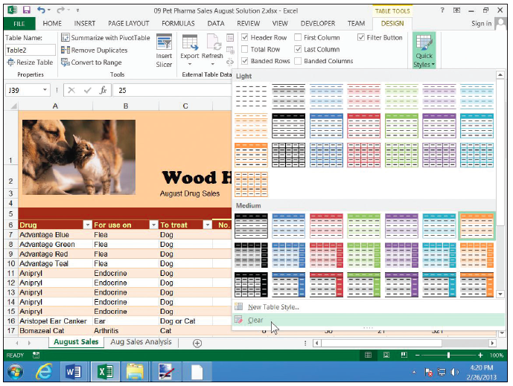
Step by Step: Remove Styles from a Table
GET READY. USE the workbook from the previous exercise.
SAVE the workbook in the Lesson 9 folder as 09 Pet Pharma Sales August Solution 2.
In the August Sales worksheet, click any- where inside the table.
On the DESIGN tab, in the Table Styles group, click the More down arrow button. (Or if you see only the Quick Styles button, click that instead.)
In the menu, as indicated above, click Clear.
Notes:
Troubleshooting: There are two places to find the table styles menu in Excel. One is under the Format as Table button of the Home menu tab. The other is in the Table Styles group of the Design menu tab. At first, both menus look the same. But only the one on the DESIGN tab has the Clear button to remove styles from a table.

Slide 67
Step by Step: Remove Styles from a Table
To change the table style to something that contrasts against the others in this series, bring up the Quick Styles menu again, and this time choose Table Style Light 6 (upper right corner).
To automatically apply boldface to the rightmost column, in the Table Style Options group, ensure Last Column is checked. To do the same for the leftmost column, check First Column.
SAVE the workbook and LEAVE it open for the next exercise.

Slide 68
Step by Step: Define a Title for a Table
GET READY. USE the workbook from the previous exercise.
SAVE the workbook in the Lesson 9 folder as 09 Pet Pharma Sales August Solution 3.
In the August Sales worksheet, click anywhere inside the table.
On the DESIGN tab, in the Properties group, click the text box under Table Name.
Type DrugSales (all one word) and press Enter. You have given a name to the table. Now you can replace the strange-looking formulas at the bottom of the August Sales worksheet with formulas that are easier to read, yet yield the same results.
Select cell D97 (Total Sales).

Slide 69
Step by Step: Define a Title for a Table
Type =sum(Dr
When DrugSales appears in the list, press Tab.
Type [ (left square bracket).
Use the arrow keys to select Total Sales from the list, and then press Tab.
Type ] (right square bracket), followed by ) (right parenthesis) and Enter. If you enter the formula properly, the result should be identical to what was there before.
Replace the formula in cell D98 with the following:
=SUMIF(DrugSales[To treat],"Dog",DrugSales[Total Sales])
Replace the formula in cell D99 with one based on the formula in D98, but searching for Cat instead of Dog.
SAVE the workbook and leave it open for the next exercise.

Slide 70
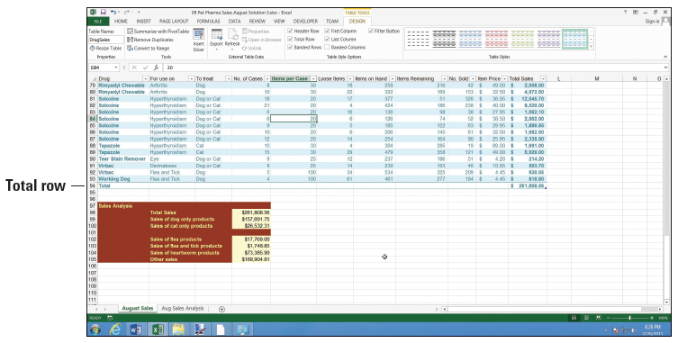
Step by Step: Use the Total Row Command in a Table
GET READY. USE the workbook from the previous exercise.
Select any cell in the table. Excel adds the DESIGN tab to the ribbon.
With the August Sales worksheet active, on the DESIGN tab, in the Table Style Options group, select the Total Row box. Excel adds a total row to the bottom, as shown above, with a label in the leftmost column and the grand total in the rightmost column.

Slide 71
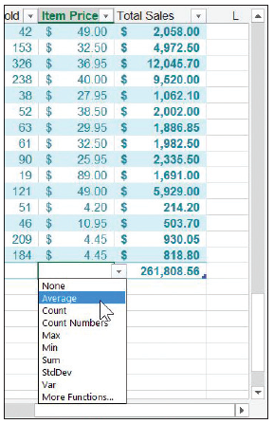
Step by Step: Use the Total Row Command in a Table
To add other subtotals or formulas to the Total Row, you can choose one from a drop-down menu. Click the cell in the total row at the bottom of the Item Price column.
Click the down arrow that appears to the right of the blank cell. In the popup menu (right), click Average. Excel calculates the average price per sales item.
Repeat the process to find the maximum number of items sold in one order, by choosing the Max function for the No. Sold column.
SAVE the workbook and leave it open for the next exercise.

Slide 72
Step by Step: Add and Remove Rows and Columns in a Table
GET READY. USE the workbook from the previous exercise.
SAVE the workbook in the Lesson 9 folder as 09 Pet Pharma Sales August Solution 4.
In the August Sales worksheet, select cell A88 (in the Drug column).
On the HOME tab, in the Cells group, click the Insert down arrow. In the menu, click Insert Table Rows Above.
Type the following values into cells A88:F88:
Soloxine Hyperthyroidism Dog or Cat 7 20 2
Note that the value in the Items on Hand column is automatically updated, because Excel copied the formula into the new row.
Notes:
Another Way: To insert multiple contiguous rows in a table, start by selecting a block of cells that’s as tall as the number of rows you want to insert.

Slide 73
Step by Step: Add and Remove Rows and Columns in a Table
Select cell H88 (in the Items Remaining column) and type the value 41. Cell I88 is updated.
Select cell J88 (in the Item Price column) and type the value 25.95. Cell K88 is updated.
Select any cell in row 32.
On the HOME tab, in the Cells group, click the Delete down arrow. In the menu, click Delete Table Rows. Row 32 is deleted, and the table shrinks to fit.
Select any cell in column I (No. Sold).
On the HOME tab, in the Cells group, click the Delete down arrow, and then click Delete Table Columns. Column I is removed, and for the time being, #REF! errors are generated throughout the Total Sales column, which contain formulas that referred to No. Sold.

Slide 74
Step by Step: Add and Remove Rows and Columns in a Table
With a cell in column I still selected, click the down arrow next to Insert in the Cells group, and in the menu, click Insert Table Columns to the Left.
Change the header in cell I6 to read No. Sold.
Click cell I7 and enter the formula =[Items on Hand]-[Items Remaining]. Use the “IntelliSense” menus when you type each left bracket [ to expedite your entry. Notice when you press Enter that Excel automatically copies the formula down the remainder of the column. You normally don’t have to do this manually for a table.

Slide 75
Step by Step: Add and Remove Rows and Columns in a Table
Click cell K7 and enter the formula =[No. Sold]*[Item Price]. This time when you press Enter, Excel does not fill the formula down the column, because it will not auto-fill over non-blank cells.
Fill the new Total Sales formula down to row 93, making sure to stop short of the total row. The grand total formula in cell K94 is now fixed.
Click cell L7, outside the table.

Slide 76
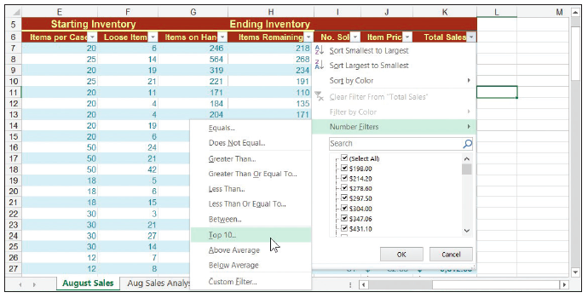
Step by Step: Add and Remove Rows and Columns in a Table
Enter the formula =[Total Sales]/AVERAGE([Total Sales]). Notice you don’t get the “IntelliSense” menus this time, because the cell pointer is not inside the table. After you press Enter, Excel not only creates the formula but extends the table one column to the right, and copies the formula down the entire column L. For now, Excel gives the new column the temporary name Column1 (above).
Notes:
Take Note: Excel doesn’t apply its auto-completing IntelliSense feature for table field names while you enter data outside the table.

Slide 77
Step by Step: Add and Remove Rows and Columns in a Table
Rename the new column % of Avg.
Select cell range L7:L93 and give the range a percent style. Excel does not automatically copy custom cell styles down a column, so you must select the range manually first. Note how Excel has moved the last column’s boldfaced format from Total Sales to % of Avg.
Click any cell in % of Avg., and then click the down arrow next to Delete. Click Delete Table Columns. As the appended column disappears, the boldfacing is returned to Total Sales.
SAVE the workbook and leave it open for the next exercise.
Notes:
Take Note: In the % of Avg. formula, the first instance of @[Total Sales] in =[Total Sales]/AVERAGE([Total Sales]) refers to just the total that appears in the current row, as denoted by the @ prefix. In the second instance, [Total Sales] as the argument for the AVERAGE() function refers to the entire column. Think of the @ character as an exclusive symbol meaning, “just the value of the column in this same row as this formula.” The omission of this character before the column name, therefore, may be interpreted to mean “everything in this column.”

Slide 78
Step by Step: Filter Records in a Table
GET READY. USE the workbook from the previous exercise.
In the August Sales worksheet, click the down arrow beside Total Sales.
In the menu (below), click Number Filters, and then click Top 10. The Top 10 AutoFilter dialog box appears.

Slide 79
Step by Step: Filter Records in a Table
Leave the choices set at Top 10 items, and then click OK. The table is filtered down to the 10 items with the highest sales.
SAVE and CLOSE the workbook and leave Excel open for the next exercise.
Notes:
Another Way: A quick way to filter a column by the contents of one of the visible cells in that column is to right-click that cell, click Filter in the menu, and then click Filter by Selected Cell’s Value.
Take Note: The Top 10 items filter always results in 10 items displayed (unless the table has fewer than 10 records to begin with). By comparison, the Top 10 percent filter displays however many records comprise the top 10 percent of the values in the filtered column.

Slide 80
Step by Step: Sort Data on Multiple Columns in a Table
GET READY. RE-OPEN the 09 Car Owners Solution workbook from earlier in this lesson.
SAVE the workbook in the Lesson 9 folder as 09 Car Owners Solution 2.
Select the range A1:G73.
On the HOME tab, in the Styles group, click Format as Table. In the menu, click Table Style Medium 14.
In the Format As Table dialog box, click OK.
Because this range contains data appended from an outside source (see the “Appending Data to a Worksheet” section earlier in this lesson), the query data related to that outside source is still attached to the range. Click Yes in the dialog box to have Excel remove those connections.

Slide 81
Step by Step: Sort Data on Multiple Columns in a Table
Click the Name box and rename the table Owners.
Resize columns B, E, and F to more appropriately fit their contents.
Change the font for the entire table to Cambria, 11 pt.
Left-justify column G.
With the Owners table selected, on the DATA tab, in the Sort & Filter group, click Sort. The Sort dialog box appears.
In the Sort by list box under Column, choose Last Name.
Click Add Level.
In the Then by list box that appears under Column, choose First Name. Click OK.
SAVE the workbook and leave it open for the next exercise.

Slide 82
Step by Step: Change Sort Order in a Table
GET READY. USE the workbook from the previous exercise.
With the cell pointer in the Owners table, on the DATA tab, in the Sort & Filter group, click Sort.
In the Sort dialog box, click Delete Level, and then click Delete Level again, to remove the existing sort order.
Click Add Level.
In the Sort by list box that appears, click ZIP. Click OK.
SAVE the workbook and leave it open for the next exercise.

Slide 83
Step by Step: Remove Duplicates in a Table
GET READY. USE the workbook from the previous exercise.
Click any cell inside the table.
On the DESIGN tab, in the Tools group, click Remove Duplicates.
The Remove Duplicates dialog box lets you determine how much of a record needs to be duplicated before it qualifies as a duplicate. For instance, two or more customers might have the same name, though they probably don’t share the same address or phone number. In the Columns list, uncheck City, State, and ZIP.
Click OK. Excel shows a dialog box reporting how many duplicate entries were removed. Click OK to dismiss.
SAVE and CLOSE the workbook and leave Excel open for the next exercise.
Notes:
Take Note: After Excel finds duplicate rows, it removes the lowermost duplicates from the table, leaving the row on top. This is important when you remove rows based on some, not all, the fields in the rows. Excel does not automatically reconcile the contents of rows deemed to be duplicates, so any data in the lowermost rows that does not appear in the uppermost duplicate row will be deleted without asking you first.

Slide 84
Step by Step: Use a Slicer to View Table Data
GET READY. RE-OPEN the 09 Pet Pharma Sales August Solution 4 workbook for this lesson.
SAVE the workbook in the Lesson 9 folder as 09 Pet Pharma Sales August Solution 5.
On the DATA tab, in the Sort & Filter group, click Clear.
Click any cell inside the table.
On the DESIGN tab, in the Tools group, click the Insert Slicer button.

Slide 85
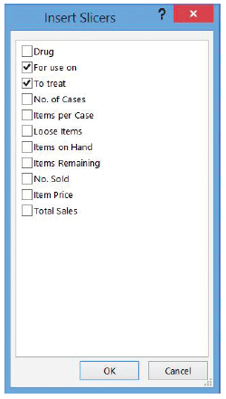
Step by Step: Use a Slicer to View Table Data
The Insert Slicer dialog box contains empty check boxes for each of the fields for which you can create buttons (right). Click For use on and To treat.
Click OK. As the dialog box disappears, the two slicer tools appear as graphic objects in the center of the worksheet. They’re not actually inside the table; for the moment, they’re just in the way of it.

Slide 86
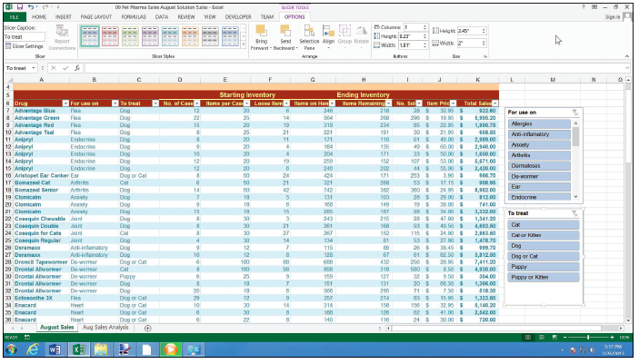
Step by Step: Use a Slicer to View Table Data
Relocate the For use on slicer by dragging its title bar toward the upper right of the worksheet. As you drag toward the edge of the window, the worksheet automatically scrolls to reveal space where you can drop the slicer. Drop the slicer when it’s to the right of the table, just beneath the headers row.
Repeat the process with the To treat slicer, dragging it below the For use on slicer. The worksheet should look similar to the figure at right.

Slide 87
Step by Step: Use a Slicer to View Table Data
To see just the treatments that apply to dogs only, click Dog on the To treat slicer. Note that the AutoFilter button for the To treat column shows a filter has been applied.
To show just the treatments that apply to the endocrine system, click Endocrine on the For use on slicer. Note that the filters from both slicers apply simultaneously, so you should see endocrine system treatments for dogs only. The slicer highlights only the criterion in use for the current filter.
To clear the filters using the slicers, click the Clear Filter button in the upper right corner of each slicer.
SAVE and CLOSE the workbook and leave Excel open for the next exercise.
© 2014, John Wiley & Sons, Inc.
Microsoft Official Academic Course, Microsoft Word 2013
87
Notes:
Troubleshooting: When an AutoFilter button for a column is used to filter a table and a slicer exists for that same column, the slicer shows the criteria currently in use for that filter. However, the Clear Filter button for the slicer is disabled. To clear this filter, you have to use the AutoFilter button.

Slide 88
Step by Step: Convert a Table to a Range
GET READY. RE-OPEN the 09 2005 Customers Solution workbook for this lesson.
Near the top of the Excel window, respond to the security warning by clicking Enable Content.
SAVE the workbook in the Lesson 9 folder as 09 2005 Customers Solution 2.
Click any cell inside the table.
On the DESIGN tab, in the Tools group, click Convert to Range.
Excel opens a dialog box to verify this conversion is what you want. Click OK. The AutoFilter buttons are removed from the header row and entries are left sorted as they were. Subtotals and total rows remain, and formatting is left as it was.
SAVE and CLOSE the workbook and leave Excel open.

Slide 89
Step by Step: Record a Basic Macro
GET READY. OPEN the 09 4Strong Tour Revenues workbook for this lesson.
Click the FILE tab, and then click Options.
In the Excel Options dialog box, click Customize Ribbon.
In the Main Tabs list on the right, check the Developer box if it is not already checked. This adds the DEVELOPER tab to Excel, enabling you to record macros. Click OK.
The macro that you will record creates a custom subtotal row at the place you define, rather than at some place Excel determines. The rule you’ll follow is that the user (you) must select the cell where you want the subtotal to appear, and then run the macro. So to prepare for recording, click cell D21.

Slide 90
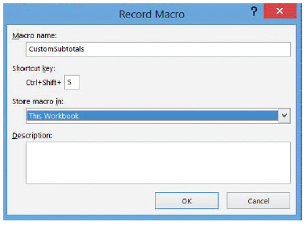
Step by Step: Record a Basic Macro
On the DEVELOPER tab, in the Code group, find Use Relative References. If it is not highlighted, click to select it. You want relative references for this macro.
In the Code group, click Record Macro.
In the Record Macro dialog box, click the Macro name box and type CustomSubtotals.
In the Shortcut key box beside Ctrl +, type the capital S. This changes the shortcut key to Ctrl + Shift + S. Leave Store macro in set to This Workbook. The dialog box should now appear as sown above.

Slide 91
Step by Step: Record a Basic Macro
Click OK. You are now recording a macro.
Press Shift + Down Arrow.
On the HOME tab, in the Cells group, click the Insert arrow. In the menu, click Insert Sheet Rows.
Press Shift + Up Arrow.
In the Editing group, click AutoSum. Do not press Enter yet.
In the Clipboard, click Copy.
Press Tab.
Type the partial formula =max(
In the Clipboard group, click Paste.
Type ) (end parenthesis) and press Tab.
Press Left Arrow.
Click $ (Accounting Number Format) in the Number group.
Notes:
Troubleshooting: If you mess up a step during the macro recording, don’t worry. Click Stop Recording in the Code group of the Developer menu tab. Then start again from Step 6. Use the same name, and when Excel asks whether you want to overwrite the existing macro with the same name, respond with Yes.

Slide 92
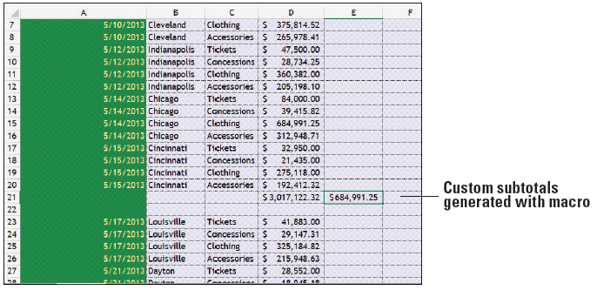
Step by Step: Record a Basic Macro
On the DEVELOPER tab, in the Code group, click Stop Recording.
Now that you’re not recording, adjust the width of column E to fit its content. As shown at right, the macro generates a total for the bottom of the arbitrary cluster of records, and also tabulates the highest value in that cluster in the cell adjacent to the subtotal.

Slide 93
Step by Step: Record a Basic Macro
Click the FILE tab, and then click Save As.
In Backstage, locate the Lesson 9 folder.
In the Save As dialog box, under Save as type, choose Excel Macro-Enabled Workbook (*.xlsm).
SAVE the workbook as 09 4Strong Tour Revenues Solution.xlsm and leave it open for the next exercise.
Notes:
Another Way: In the green status bar along the bottom of the Excel window, there’s an icon that looks like a worksheet with a dot in the upper left corner, as shown in Figure 9-44. Click this to bypass the ribbon and immediately start recording a new macro. Click the same spot again to stop recording.

Slide 94
Step by Step: Run a Macro
GET READY. USE the workbook from the previous exercise.
Click cell D39.
On the DEVELOPER tab, in the Code group, click Macros.
In the Macro dialog box, click CustomSubtotals. Click Run. The custom subtotals row is added immediately, with a one-row gap between the clusters.
Click cell D57.
Press Ctrl + Shift + S. The custom subtotals row appears here immediately.
SAVE the workbook and leave it open for the next exercise.

Slide 95
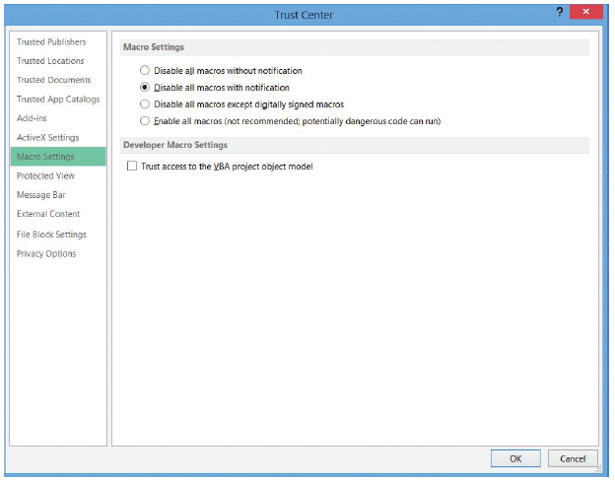
Step by Step: Manage Macro Security
GET READY. USE the workbook from the previous exercise.
On the DEVELOPER tab, in the Code group, click Macro Security.
In the Trust Center dialog box (right), click Disable all macros with notification to have Excel warn you whenever an opened workbook contains macros, enabling you to turn those macros on or off based on your decision.
Click OK.
CLOSE the workbook. CLOSE Excel.

Slide 96
Skill Summary

Slide 97
Skill Summary

